Slide 1
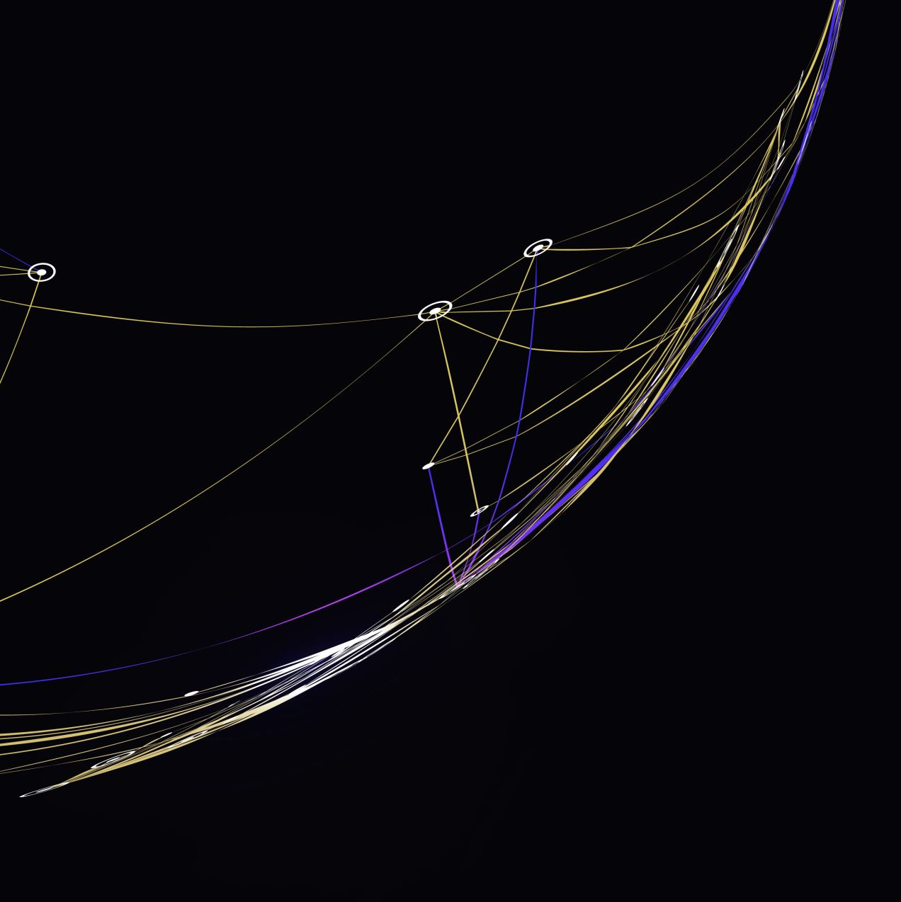
The Battle of the Neighborhoods

Slide 2
Intro to the Problem and the Data

Slide 3
Methodology

Slide 4
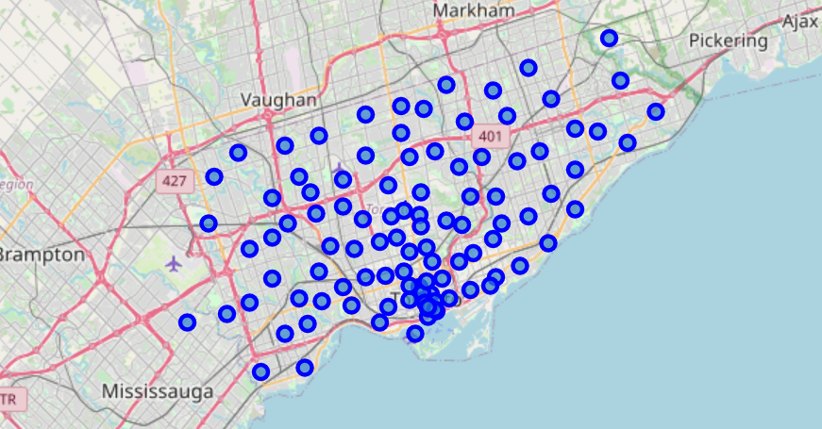
Neighborhoods in Toronto

Slide 5
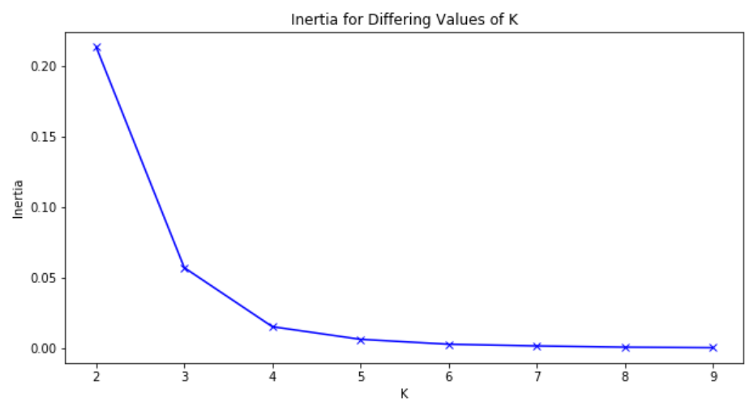
Clustering: Elbow

Slide 6
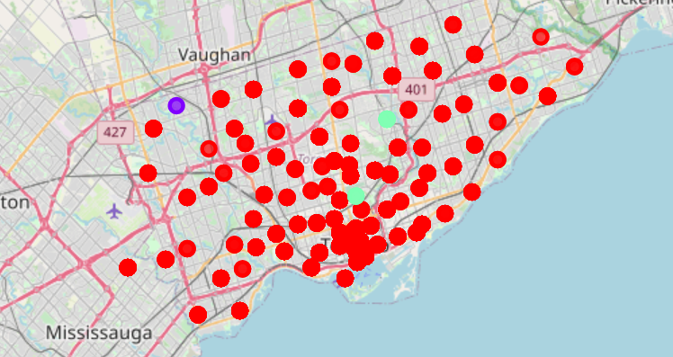
3 Clusters:

Slide 7
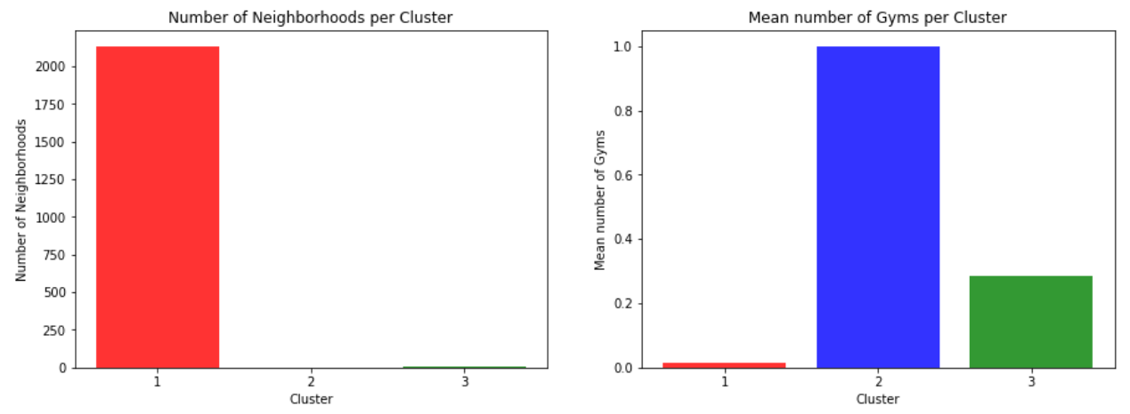
Results

Slide 8
Cluster 1!

Slide 9
Conclusion…

